Slide 1

WHAT ARE THE GREENEST NATIONS IN THE WORLD? AND WHY?
CAPSTONE

Slide 2
Goals
Success Criteria / Metrics
The goal of this project is to use some of the tools we have learnt on DSI to:
Explore all the factors that go into making a Nation ‘Green’
Find correlations between Nations, they’re levels of success
Then use this information to build a better picture to gain any insights
For our purposes, we’ll use:
Correlations (positive or negative)
R2 Score
But first, how do we know how ‘Green’ a Country is in the first place? We’ll use the EPI…

Slide 3
Environmental Performance Index
Developed by Yale, this Index provides a data-driven summary of the state of sustainability around the world. Using 32 performance indicators across 11 issue categories, the EPI ranks 180 countries on environmental health and ecosystem vitality

Slide 4
DATA Sources: Yale, Worldbank
We’ll use two sets of Data; the EPI data and other non-environmental data
Environmental Data (Contains 11 ‘Issue’ categories below):
Air Quality
Sanitation & Drinking Water
Heavy Metals
Waste Management
Biodiversity & Habitat
Ecosystem Services
Fisheries
Climate Change
Pollution Emissions
Agriculture
Water Resources
Non-Environmental Data (Obtained from other sources):
Country
Region
GDP
Population
Debt to GDP Ratio
Area KM²
Density KM²
Population Growth Rate %
World % of Population
Life Expectancy

Slide 5
Overall Approach
As the EPI score for 2020 is a continuous target variable, this is a regression project, I’ll use Simple and Multi Linear regression
Will do analysis on both datasets with an emphasis on non-EPI (as the EPI is derived from the environmental data)
Data Cleaning
Use descriptive stats
Visual analysis; correlation heatmaps, plots, and other visualisations
Set up predictor matrix(-ces) (X) and target arrays (y)
Find Baseline
Train/test split and StandardScaler
Use cross-validation

Slide 6
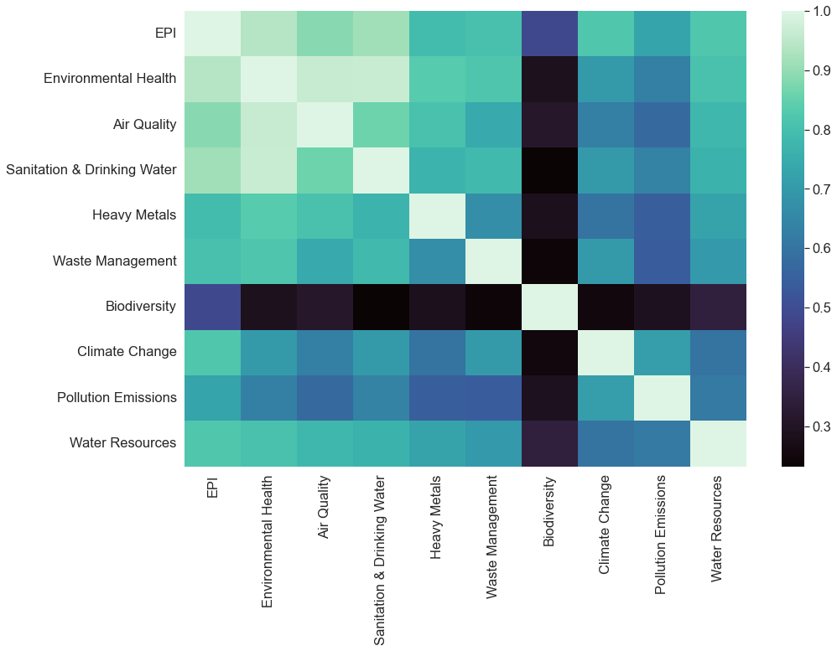
Correlation Heatmap
Looking at the correlation heatmap for the EPI score vs its components, you can get a good idea of the weighting / aggregation they assigned to each of the 11 ‘Issue’ categories without having to delve into their detailed report.
Environmental Health, being the objective and essentially what the EPI is trying to measure, is unsurprisingly the most correlated.
Air Quality and Sanitation & Drinking Water are the 2 categories that carry the most weight in terms of the EPI, so any further look at the individual components of the EPI will be around these two.
For comparison, Biodiversity appears to be the least correlated.

Slide 7
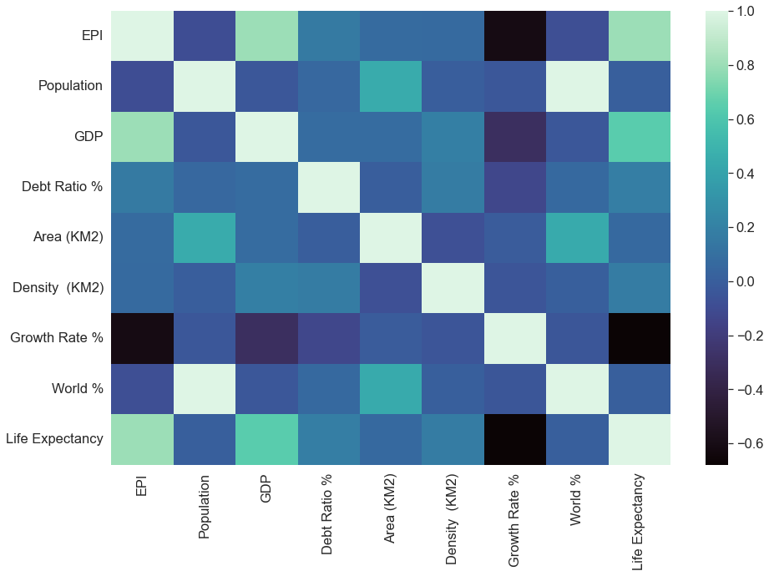
Correlation Heatmap
The first thing that is clear, is that a country's size, population and population density have nil to a slightly negative correlation to the EPI.
Further, there is a strong negative correlation between a nation's population growth rate and their EPI score. Developing Nations find Green initiatives most challenging.
The two most positively correlated variables are GDP and life expectancy. GDP is hardly surprising and is something Yale pointed out themselves.
The life-expectancy, is this another variable that is strongly related to wealth? Or is there a correlation between a Nation's social and environmental policies?

Slide 8
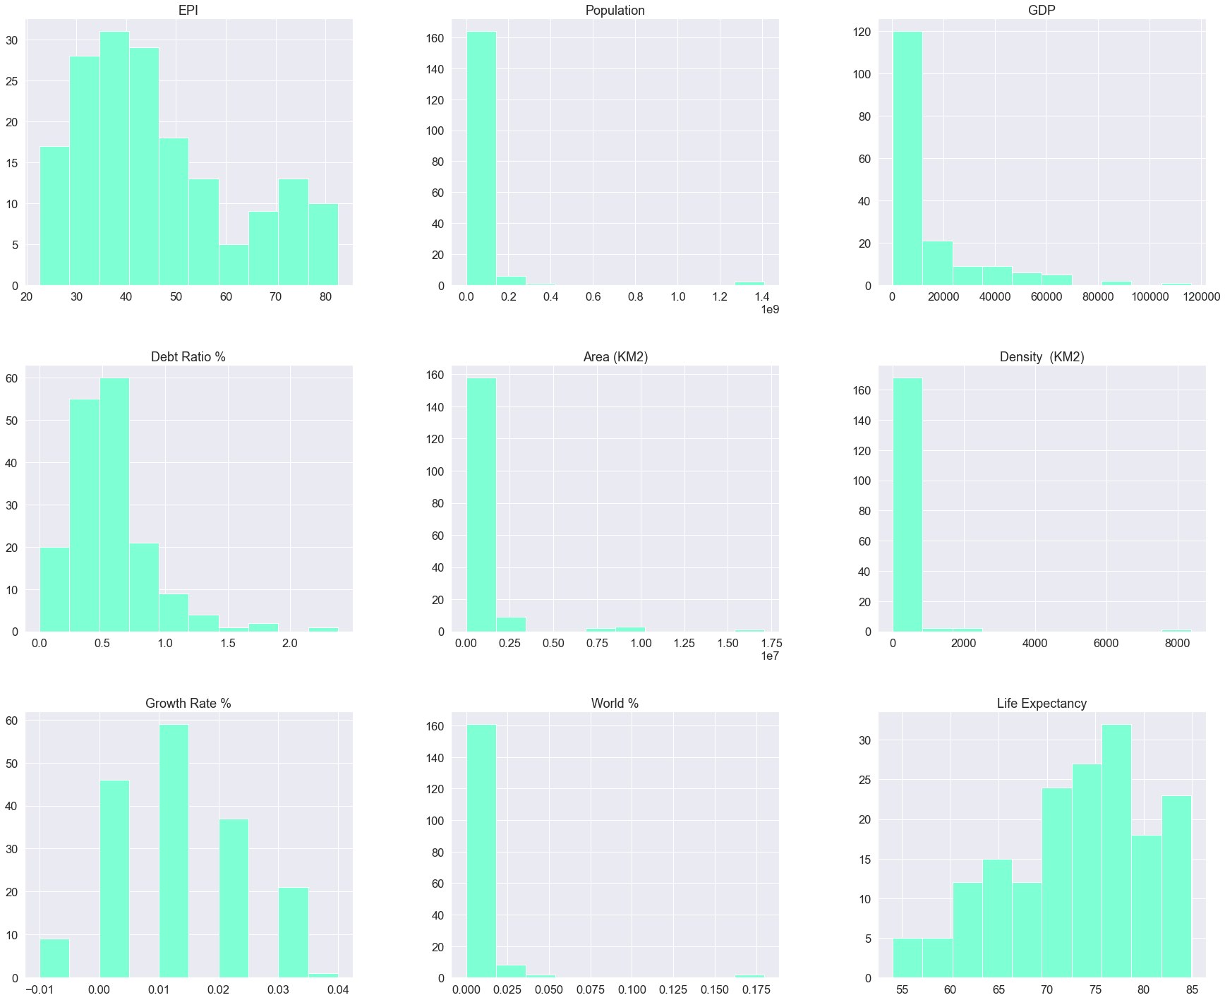
Histogram Check Distribution of EPI, Non-Environmental Variables
Distribution on my target (y) variable is a bit skewed. To combat this I could opt to use the EPI 10 year change data which is slightly more evenly distributed

Slide 9
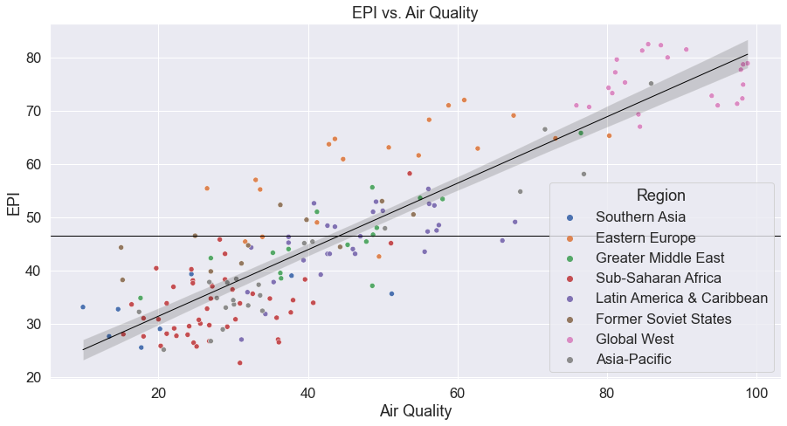
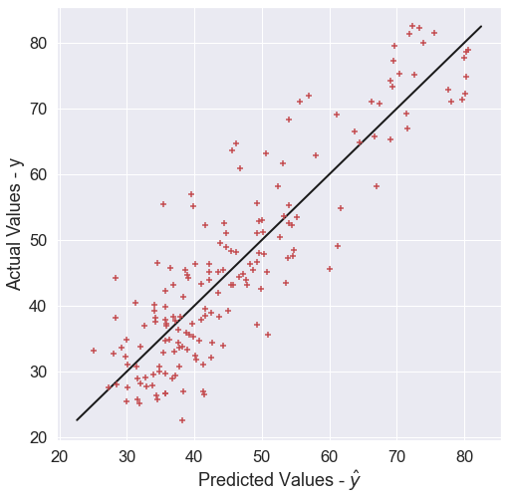
As the EPI contains, or is partly derived from, the environmental factors, I won’t do any further analysis on those, the plot and the metrics here is to demonstrate a strong correlation
Intercept: 18.78
Coefficients: [0.62521411]
R2 Score: 0.78
MSE: 51.48
RMSE: 7.17

Slide 10
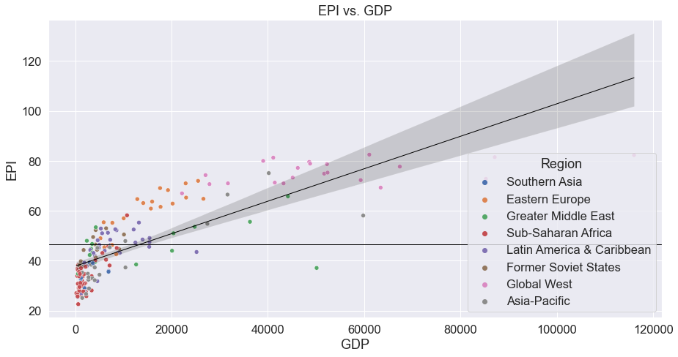
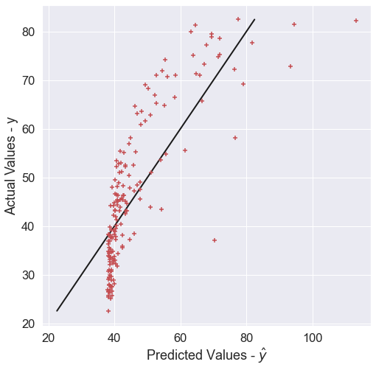
Intercept: 37.82
Coefficients: [0.00065054]
R2 Score: 0.63
MSE: 88.20
RMSE: 9.39
While not as strong a correlation as one of its strongest components, and some wealthy outliers skewing the data, the correlation between GDP and EPI here is undeniable.

Slide 11
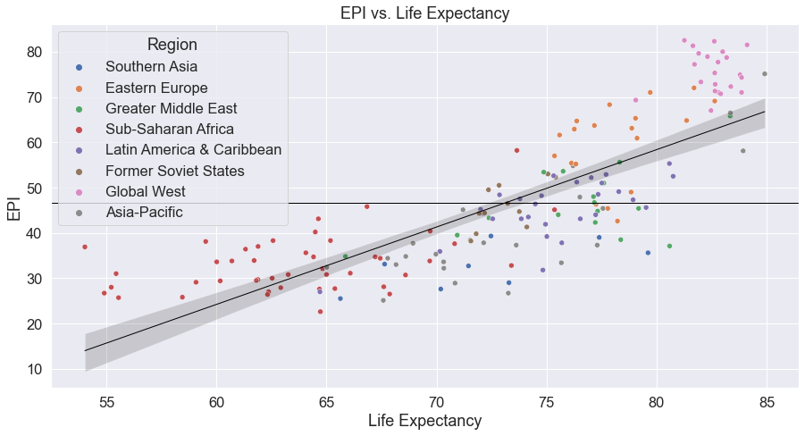
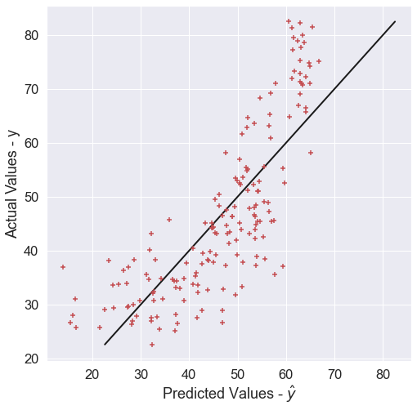
An unexpectedly strong correlation between the EPI and life-expectancy, marginally higher than with GDP. Further, the Grouping of the regions is more pronounced than with any of the other variables
Intercept: -78.27
Coefficients: [1.70]
R2 Score: 0.64
MSE: 87.30
RMSE: 9.34

Slide 12
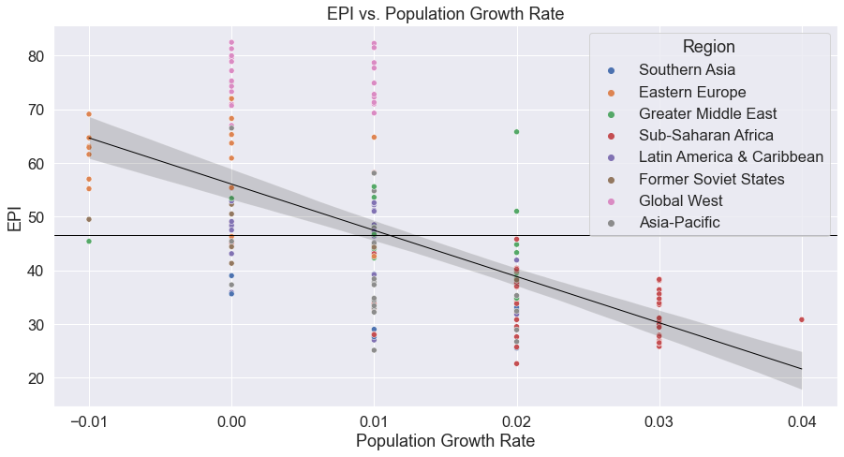
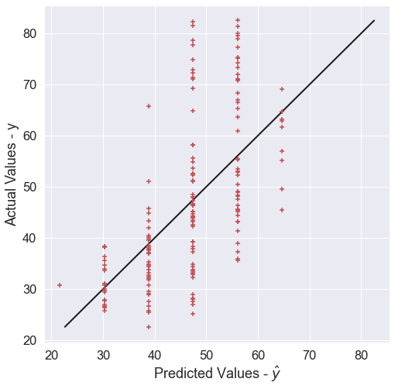
The negative correlation on display here, not between the population size but population growth is clear; uncontrolled population growth is more of an issue than large populations that have stable and sustainable growth

Slide 13
Basic Description of Model
So far we have seen only Simple Linear Regression models
However, I then went on to run Multi-Linear Regression Models of the entire non-environmental dataset
Lastly, I picked the best performing variables and selected two together (GDP and Life-Expectancy)

Slide 14
Results
 |  | Whole EPI Dataset | Whole Non-EPI Dataset | GDP & Life-Expectancy
Linear Regression | Mean CV training score | 0.94 | 0.68 | 0.73
 | R2 Training Score | 1.00 | 0.82 | 0.75
 | R2 Test Score | 0.95 | 0.82 | 0.80
Ridge | Mean CV Training Score | 0.94 | 0.77 | 0.73
 | Training Score | 1.00 | 0.85 | 0.75
 | Test Score | 0.95 | 0.83 | 0.80
 | Cross-Predicted R2 | 0.99 | 0.85 | 0.80
Lasso | Mean CV Training Score | 0.98 | 0.77 | 0.73
 | Training Score | 0.99 | 0.82 | 0.74
 | Test Score | 0.98 | 0.82 | 0.80
Elastic Net CV | Best l1-ratio | 0.99 | 0.10 | 0.10
 | Training Score | 0.99 | 0.82 | 0.74
 | Test Score | 0.98 | 0.81 | 0.80
My model did not outperform the whole dataset

Slide 15
Risks
Limitations
You can argue about the validity of the EPI and its weighting
The goal should be more about improving overall success across all metrics vs trying to ‘hack’ the EPI score and focusing on only those metrics it deems important. This is not the intention, especially as the metrics, datasets and techniques they use for the EPI change (improve) each year.
I wanted to get a lot more granular with non-environmental variables used to try and build a better predictive model
…But, time constraints among other blockers mean I’ll have to revisit this
On one hand, this issue is incredibly complex with so many interconnected variables
On the other, the data points to money being the largest of factors

Slide 16
Next Steps
Conclusions
Look further into more specific variables and particular success stories.
Build some categorical or classification models. This be done by looking at either the subsets of the EPI, or as wealth plays such an important role, countries can be grouped
An established base of wealth allows Countries to fund Green initiatives, and is the biggest predictor. Established mean already wealthy but with a lot of debt does not matter, as the debt-to-GDP ratio has shown having very little correlation to the EPI
Populations that are growing fastest vs the largest are the biggest counter-predictors

